Slide 1
GUI

Slide 2
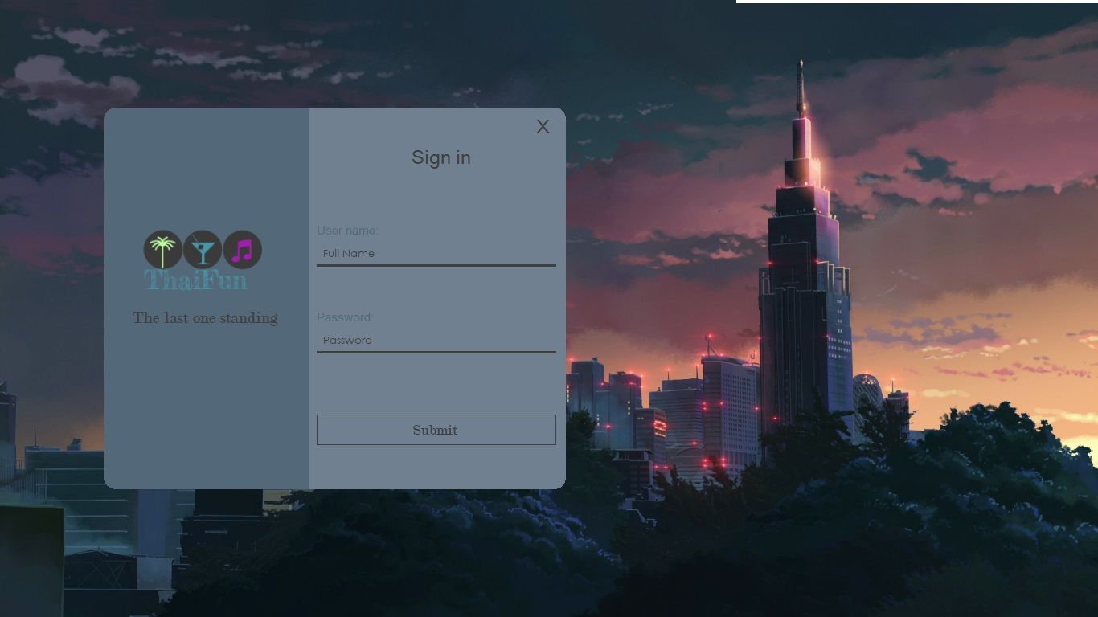
Login form

Slide 3
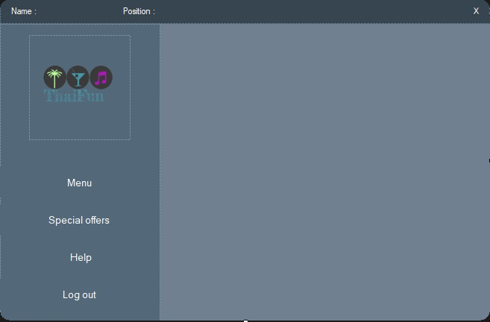
Main form

Slide 4
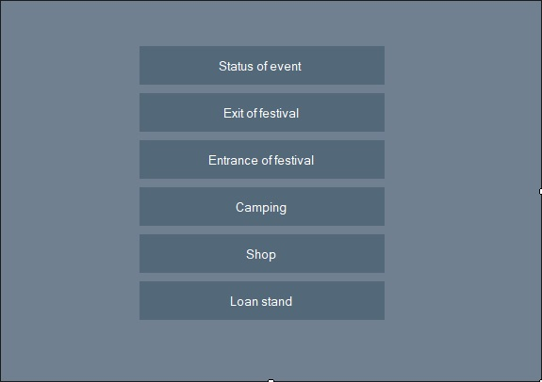
Menu

Slide 5
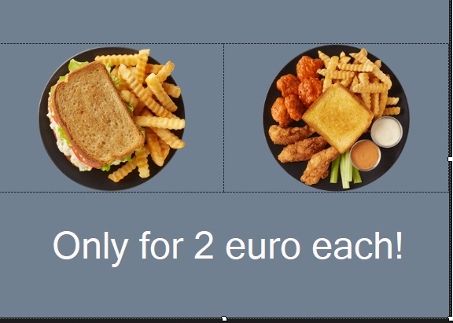
Special deals for workers

Slide 6
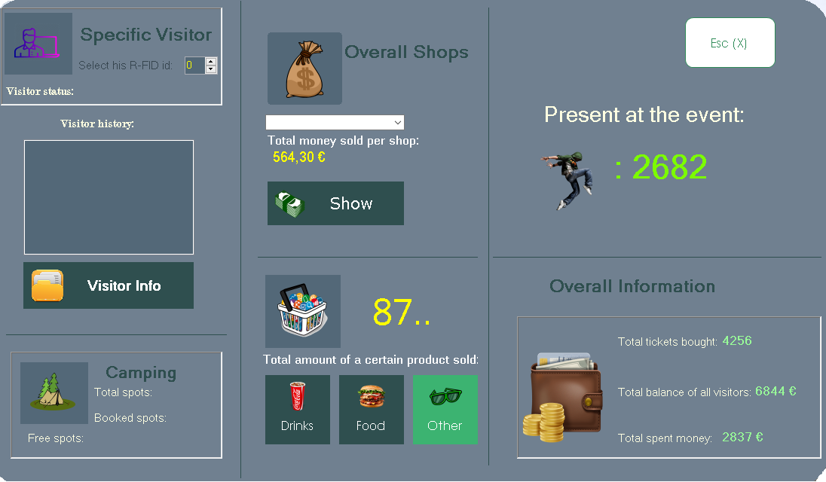
Status of the event

Slide 7

Exit form

Slide 8

Entrance form

Slide 9
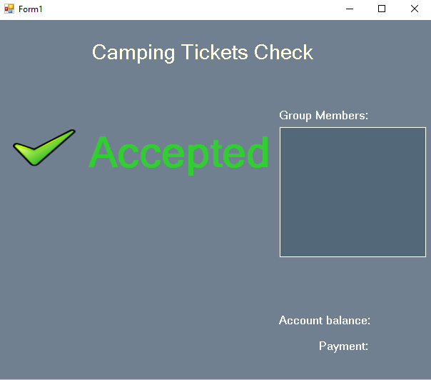
Accepted Camping

Slide 10
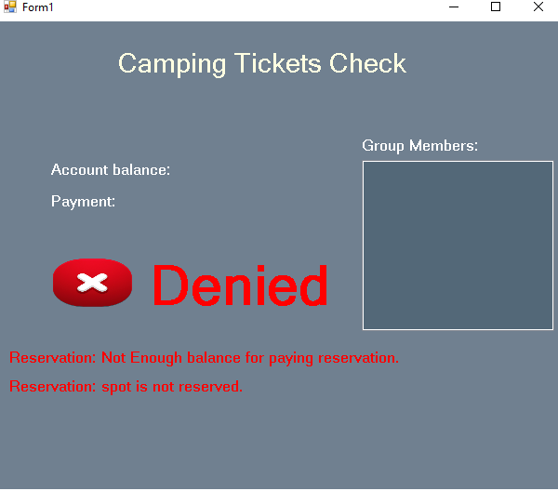
Denied Camping

Slide 11
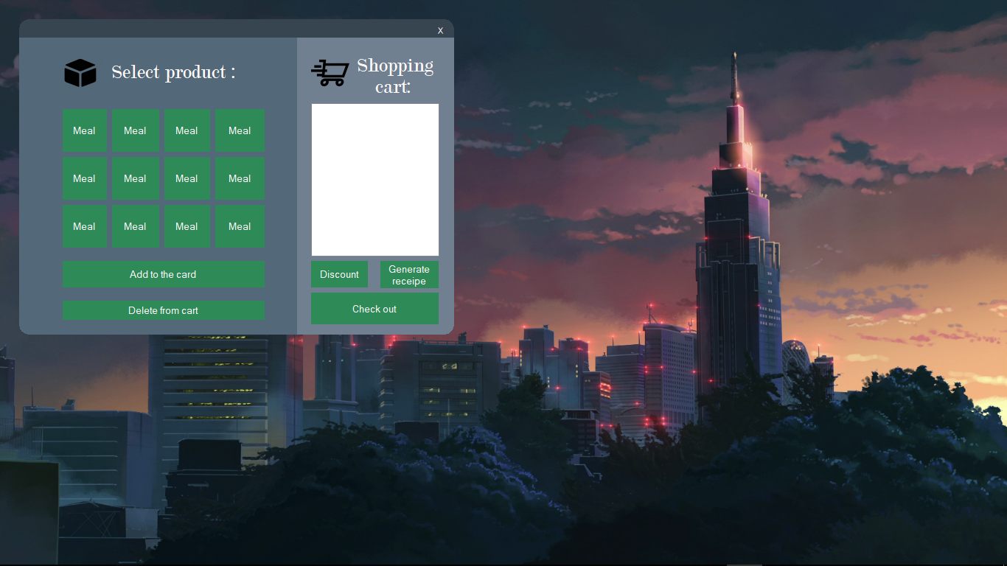
Application for shop

Slide 12
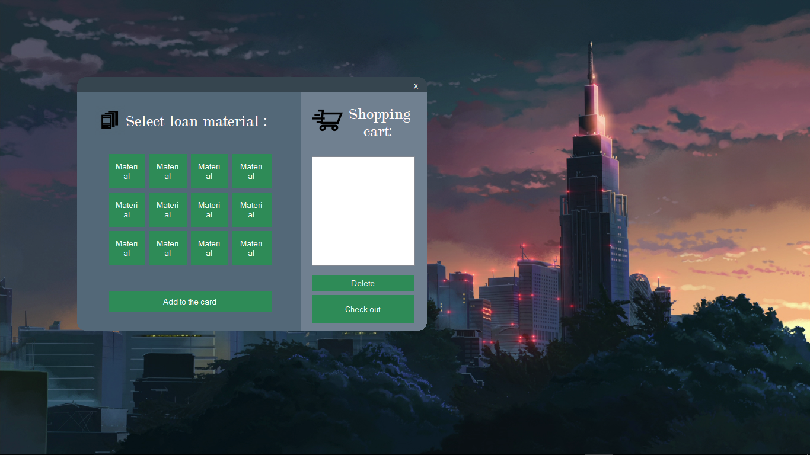
Application for loan materials

